Slide 1
Akash Trivedi
MIP-DA-13

Slide 2
Analysis of Food and Beverage Industry.

Slide 3
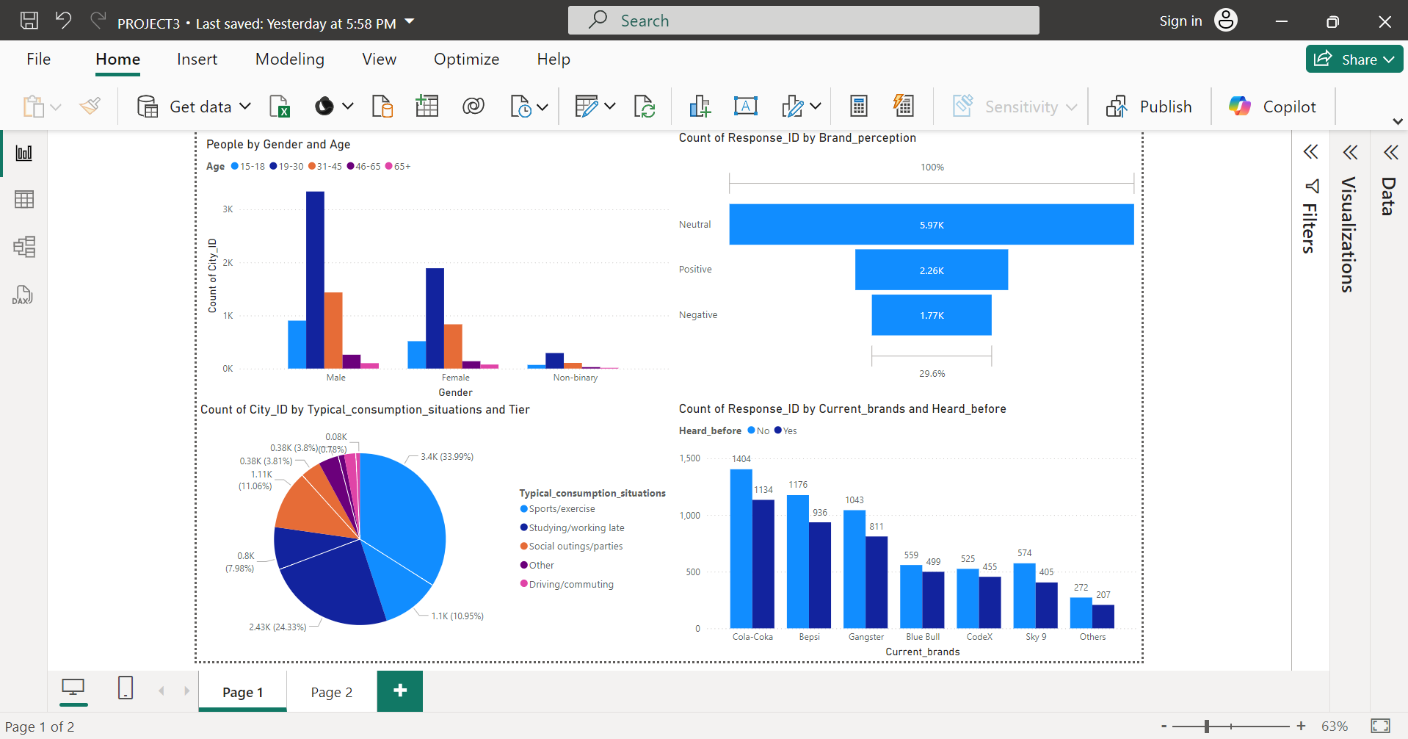

Slide 4
